Slide 1


WORLD HAPPINESS REPORT 2024
EXPLORATORY DATA ANALYSIS & PREDICTION
MUHAMMED NIHAL
MCA-37

Slide 2

1
Introduction
2
3
This project analyzes and predicts happiness scores using the World Happiness Report 2024 dataset. The dataset provides global insights into factors contributing to a country's happiness level, including economic, social, and health-related indicators. Our objective is to explore these factors, build visualizations to better understand the data, and predict happiness scores based on features like GDP per capita, social support, and life expectancy. The project involves:
4
5
6
7
Exploratory Data Analysis (EDA) to uncover trends and relationships between the variables.
Prediction of Happiness Scores using machine learning techniques, specifically Linear Regression.
8
9

Slide 3



Dataset Overview
1
2
Country name: Name of the country.
Regional indicator: The region to which the country belongs.
Ladder score: The happiness score of the country (target variable).
Log GDP per capita: The logarithmic value of the GDP per capita.
Social support: A score that measures the perceived support from others.
3
4
5
6
7
8
9

Slide 4




Dataset Overview
1
2
Healthy life expectancy: Expected life years in good health.
Freedom to make life choices: A measure of perceived freedom to make personal choices.
Generosity: A score based on donations and charitable actions.
Perceptions of corruption: The level of perceived corruption in the country.
3
4
5
6
7
8
9

Slide 5

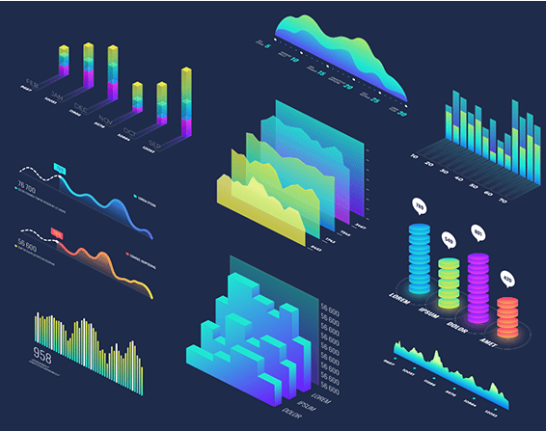

Processes
1
2
3
4
5
6
7
8
Data Pre Processing
Visualisation & Analysis
Prediction using ML
9

Slide 6
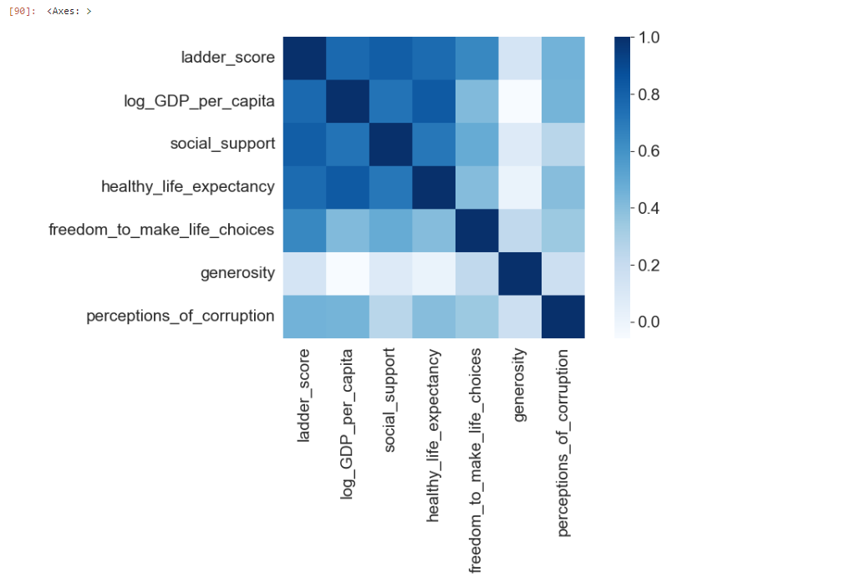
Correlation Map
1
2
3
Strong Correlations were observed between ladder_score and:
log_GDP_per_capita
social_support
healthy_life_expectancy
These relationships suggest that economic and social factors heavily influence happiness scores.
4
5
6
7
8
9

Slide 7
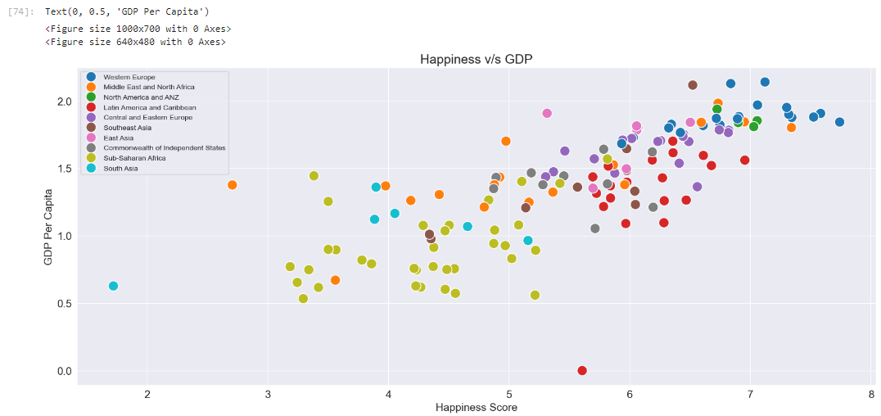
Happiness v/s GDP
1
2
3
4
5
6
7
8
9
The scatterplot revealed a positive correlation between happiness and GDP, indicating that wealthier countries tend to have higher happiness scores.

Slide 8
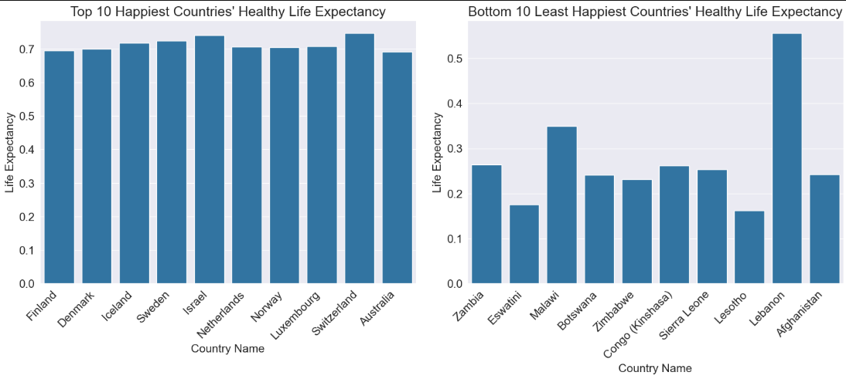
Healthy Life Expectancy
1
2
3
4
5
6
7
8
9

Slide 9
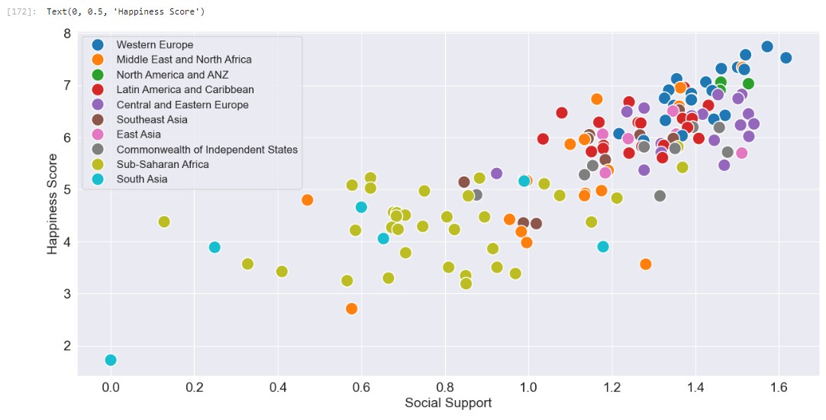
Social Support
1
2
3
4
5
6
7
8
9
The scatterplot revealed a positive correlation between happiness and Social Support, indicating that countries with better social support tends to be more happy.

Slide 10

Efficiency & Prediction
1
2
The model is evaluated using Mean Squared Error (MSE) and R-squared (R²) on the test data.
3
4
MSE: Indicates the average error in predicting the happiness score. A lower MSE means better predictions.
R²: Shows how much variance in happiness scores is explained by the features.
5
6
7
Mean Squared Error: 0.19253472096592103
R-squared: 0.8276273661852044
8
9
Also, a Linear Regression model is trained to predict the happiness scores based on the selected features.

Slide 11
THANK YOU!
MUHAMMED NIHAL

